Slide 1
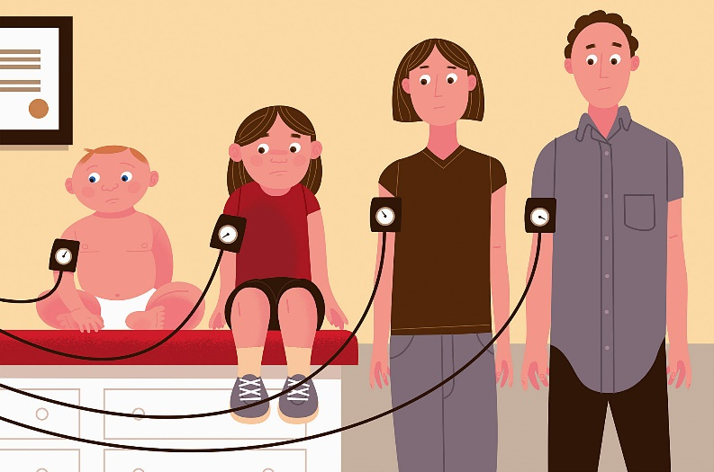
Electronics Product Design Lab Seminar on Measurement and Interpretation of Blood Pressure levels in Children and Teenagers
Shri Ramdeobaba College of Engineering and Management, Nagpur.
Presented By: Project Guide:
Nikita Kewalramani 11 Dr. Renuka Nafdey
Renuka Kadu 14 Dr. Yamini Pusdekar
Riddhi Bhute 15

Slide 2

Outline of
Presentation
Motivation
Problem Statement
Literature survey
Limitation of Present Design
Flow of project
References

Slide 3
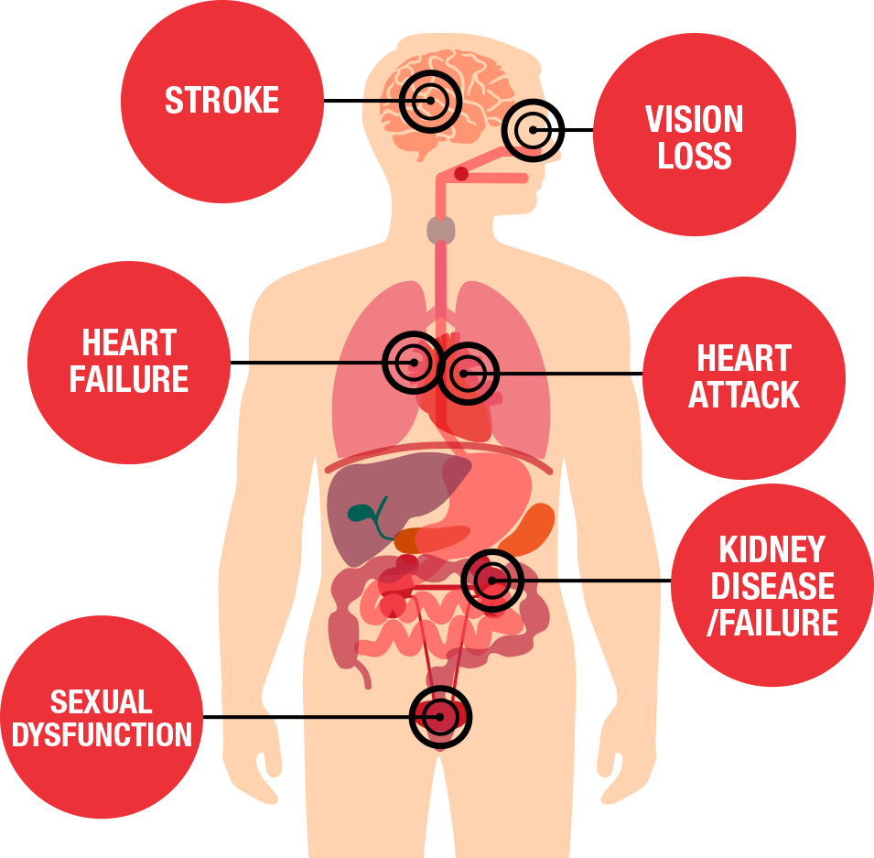
Motivation
Centers for disease control and prevention (CDC) study shows that about 1 in 25 youth ages 12 to 19 have hypertension, and 1 in 10 has elevated blood pressure (previously called “prehypertension”)
High blood pressure in youth is linked to health problems later in life.
Diagnosis of pediatric hypertension is often missed due to the absence of symptoms.

Slide 4
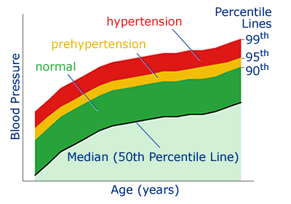
Hypertension is diagnosed based on age, gender and height-specific references.
Till the date we have no such specific or standard value of blood pressure that would indicate the normal blood pressure value for a particular child.

Slide 5
Problem Statement
“Measurement and Interpretation of Blood Pressure levels in Children and Teenagers”
The main problem is that there are no specific cut offs to determine high blood pressure in children i.e. age group between 3 to 17.
Hence, age, height and gender are also considered along with blood pressure readings to detect their hypertension.
As four parameters are to be considered, it becomes very complicated for health care professionals especially nurses to contemplate if a child has prehypertension, stage 1 or stage 2 hypertension.

Slide 6
Literature Survey
Serial No. | Name of paper | Background
1 | “Blood pressure percentile charts to identify high or low blood pressure in children” | The goal was to develop familiar blood pressure (BP) charts representing BP percentile curves similar to CDC growth charts to improve screening of both high and low BP in children.
2 | “High blood pressure in school children: prevalence and risk factors” | The purpose of this study was to determine the prevalence of high blood pressure (HBP) and associated risk factors in school children 8 to 13 years of age.

Slide 7
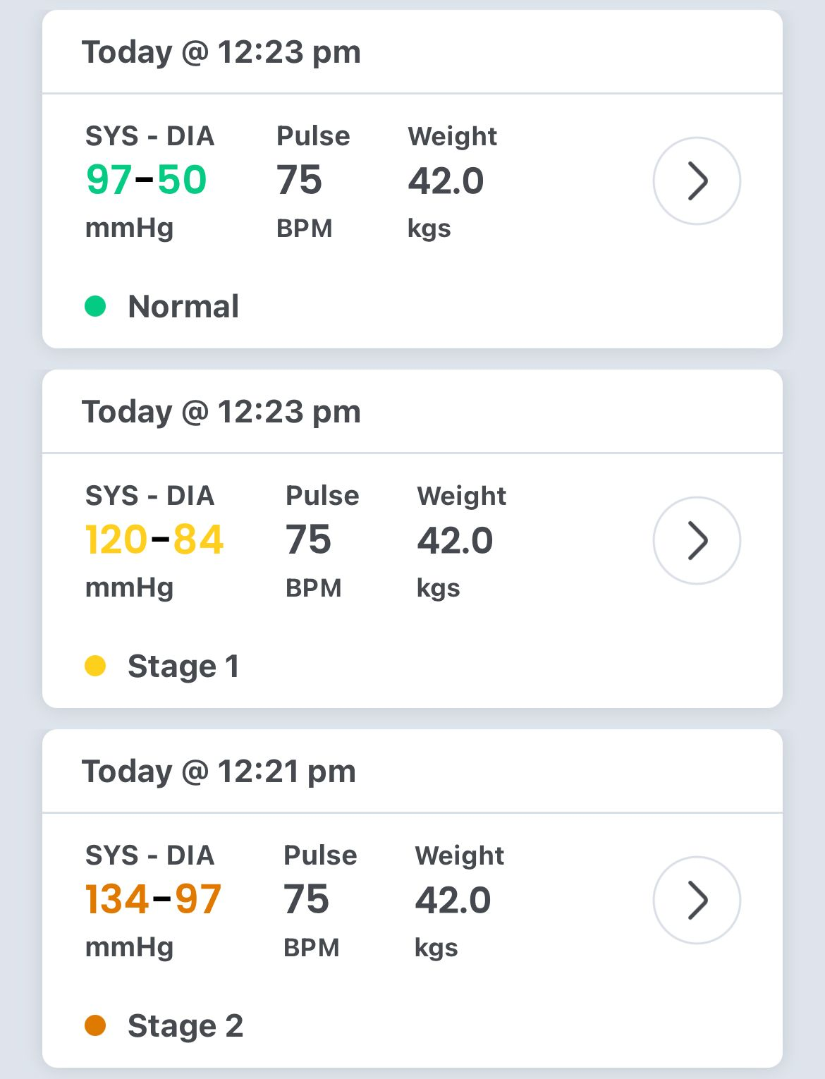
Limitations of Present Design
At the moment, applications are available to interpret and classify blood pressure in adults but the same cannot be used for children and young adults as we know multiples parameters are to be considered.
As seen in this screenshot from the app available currently, it can be seen that only the weight of the individual is considered.
We also observed that the application fails to detect hypotension (low blood pressure).

Slide 8
Flow of Project
Data Collection
Using Data science to form a database that takes all 4 parameters under consideration
Classifying the readings into Hypotensive, Normal, Prehypertensive, Stage 1 and Stage 2 Hypertensive using ML

Slide 9
References
[1] Banker A, Bell C, Gupta-Malhotra M, Samuels J. Blood pressure percentile charts to identify high or low blood pressure in children. BMC Pediatr. 2016;16:98. doi:10.1186/s12887-016-0633-7
[2] Lu Q, Ma CM, Yin FZ, Liu BW, Lou DH, Liu XL. How to simplify the diagnostic criteria of hypertension in adolescents. J Hum Hypertens. 2011;25(3):159–63. doi: 10.1038/jhh.2010.46.
[3] Somu S, Sundaram B, Kamalanathan AN. Early detection of hypertension in general practice. Arch Dis Child. 2003;88(4):302. doi: 10.1136/adc.88.4.302.

Slide 10
Thank You

